Slide 1
UNIT 3-S1 DISPLAY DEVICES,LIGHT SOURCES AND DETECTION DEVICES

Slide 2

LUMINESCENCE
It is the process where a material absorbs energy and then immediately emits visible or near-visible radiation. It consists of electron excitation and then dropping down to lower energy states.
If the emission of radiation occurs within 10⁻⁸ sec.s after excitation, the luminescence is called fluorescence, and if it takes longer than 10⁻⁸ sec.s, it is known as phosphorescence.
Ordinarily pure materials do not display this phenomenon. Special materials called phosphors have the capability of absorbing high-energy radiation and spontaneously emitting lower-energy radiation. Ex.: some sulfides, oxides, tungstates, and few organic materials.
The intensity of luminescence is given as:

Slide 3
Luminescence
Luminescence
Luminescence is spontaneous emission of light by a substance not resulting from heat; or "cold light".
It is thus a form of cold-body radiation. It can be caused by chemical reactions, electrical energy, subatomic motions or stress on a crystal. This distinguishes luminescence from incandescence, which is light emitted by a substance as a result of heating.

Slide 4
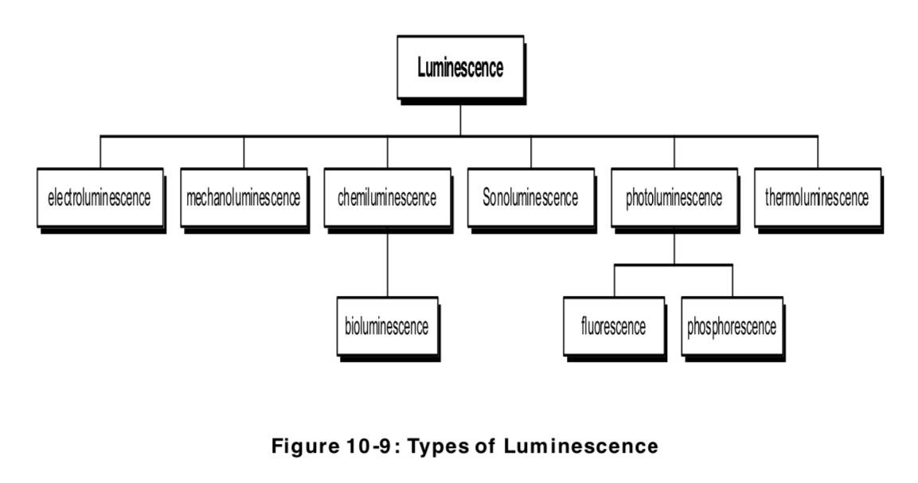

Slide 5
A material that emits light is called luminescent material
It emits energy from an excited electronic state as light.
Some of the incident energy is absorbed and re-emitted as light of a longer wavelength.
The wavelength of the emitted light is characteristic of the luminescent substance and not of the incident radiation.
The emitted light carries the materials signature.

Slide 6
PHOTOLUMINESCENCE
Based on source for electron excitation, luminescence is three types: photo-luminescence, cathode-luminescence, and electro-luminescence.
Photo-luminescence occurs in fluorescent lamps.
Here ultra-violet radiation from low-pressure mercury arc is converted to visible light by calcium halo-phosphate phosphor (Ca₁₀F₂P₆O₂₄).
In commercial lamps, about 20% of F - ions are replaced with Clions.
Antimony, Sb³⁺ , ions provide a blue emission while manganese, Mn²⁺ , ions provide an orange-red emission band.

Slide 7
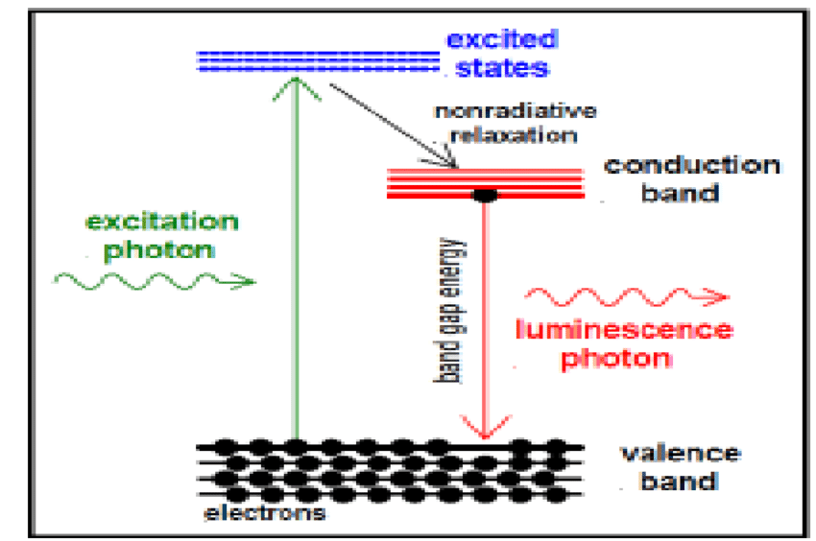

Slide 8
PHOTOLUMINESCENCE
Photoluminescence in semiconductors and dielectrics can usually only occur for illumination of a substance with light which has a photon energy above the band gap energy.
The photoluminescence usually occurs for wavelengths around the band gap wavelength.
In many cases, photoluminescence occurs only with certain dopants or impurities in a material.
For example, fluorescence can occur when rare-earth-doped laser gain media are pumped with light which can excite the rare earth ions. Here, the emission can occur in various wavelength bands corresponding to optical transitions of those ions.
One may obtain more than one photon per absorbed photon, when there is a cascade of transitions.
Photoluminescence may be largely suppressed (quenched) if there are fast non-radiative transitions to lower energy levels, leading to a very small lifetime of the excited levels..
Notes:
8

Slide 9
Fluorescence is a short-lived photoluminescence, excited by irradiation of a substance with light.
The light hitting a sample puts atoms, ions or molecules in the sample into excited states (by absorption of photons), from where they decay into lower-lying states (e.g. their ground states) through spontaneous emission of fluorescence photons.
This phenomenon is exploited for illumination, particularly in fluorescent lamps.
It also occurs at a side effect in various kinds of optically pumped lasers and amplifiers, e.g. in solid-state doped-insulator lasers and amplifiers (including fiber lasers and fiber amplifiers), in optically pumped semiconductor lasers, and in dye lasers. The resulting radiation is called fluorescent light.

Slide 10
Phosphorescence is a kind of luminescence (i.e., a kind of light emission of a medium) which lasts relatively long after excitation of the medium with light (for example many milliseconds or more).
The excitation energy is stored in metastable electronic states(excited states (particularly electronic states in laser gain media) which have a relatively long lifetime due to slow radiative and non-radiative decay), exhibiting only forbidden transitions to lower states.
There are also cases with delayed fluorescence.
As the stored energy can be released only through relatively slow processes, phosphorescence is generally much weaker than fluorescence.
Important phosphorescent materials are europium-doped strontium aluminate (Eu²⁺:SrAl₂O₄) and zinc sulfide (Eu²⁺:ZnS).
They are used e.g. in safety products such as exit signs, which are visible even under conditions of power failure, although they are not very bright.

Slide 11
Photoluminescence is sometimes used for the characterization of photonic devices or parts thereof.
For example, one may irradiate a semiconductor wafer, on which additional layers for a semiconductor laser or a saturable absorber(light absorbers with a degree of absorption which is reduced at high optical intensities) have been fabricated, with short-wavelength light for exciting photoluminescence.
The optical spectrum(the decomposition of the power or energy of light according to different wavelengths or optical frequencies) of the photoluminescence (PL spectrum) and also the dependence of its intensity on the irradiation intensity and device temperature can deliver important information for device characterization.
In particular, PL spectra and their intensity dependencies can allow one
to determine the band gap energy
to estimate the wavelength of maximum gain
to determine the composition of ternary or quaternary layers
to determine impurity levels to investigate recombination mechanisms

